Slide 1

Workflow Design Assignment
Patient In Processing For Surgery

Slide 2
Purpose
To learn how to design the workflow in real clinical setting.
To better understand the in-depth process before the surgery
To build up skills for better workflow designing.
To learn about the collaboration of inclusive action with all stakeholders
For better performance and outcome

Slide 3
Constrains
Advance surgical equipment
Underlying medical complication
Financial problem of patient
Unavailability of time
Documentation and paperwork
Friendly and balanced nature of the Medical personnel involved

Slide 4
Assumption
Insufficient skills and manpower
Immoral behavior of the stakeholders/patients
Schedule of the Staff and their availability
Information provided by the patient as per the record might not be true

Slide 5
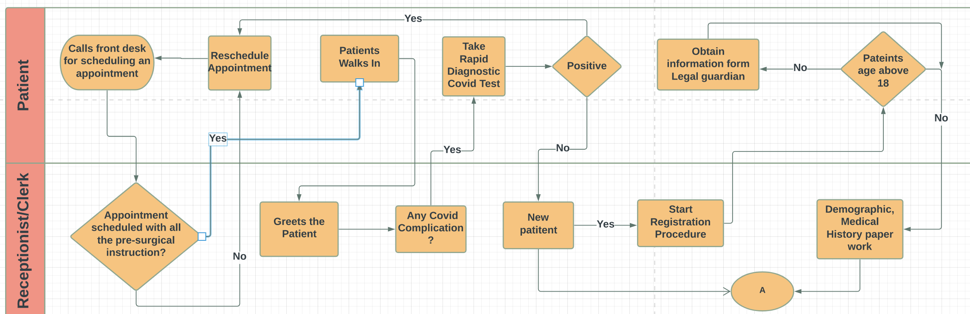

Slide 6
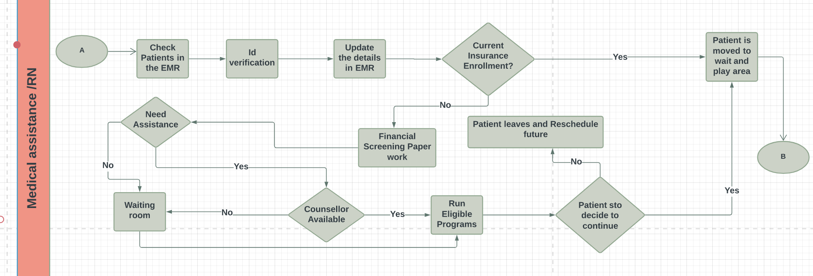

Slide 7
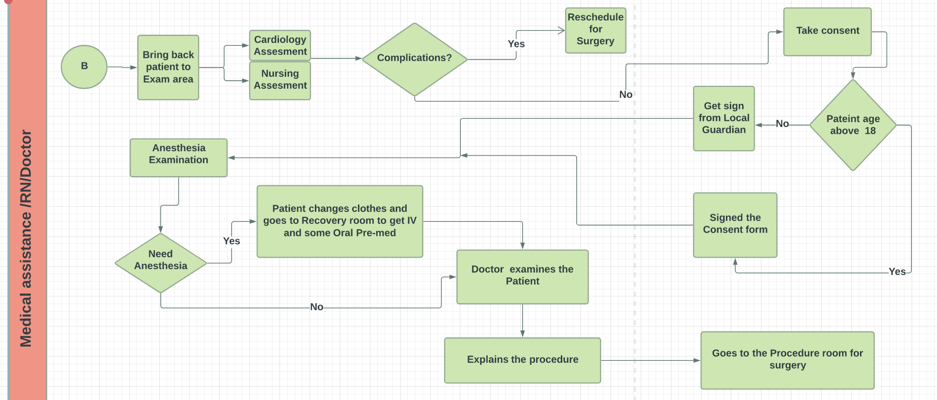

Slide 8
Limitation
Insufficient information and knowledge on clinical setting
No prior experience with workflows before
Difficult to figure out the flows based on priority
Self involvement and decision excluding other stakeholders
Missing chronological order

Slide 9
Lesson Learned
Must have depth knowledge before designing the workflow
Difficult designing the workflow without coordination along with all other stake holders
Workflow saves time and ensures accuracy and consistency
Clear predefined steps and chronological representation
Better understanding relation of time with action

